Slide 1
GOVERNMENT OF ROMANIA
Romanian Agency for Investment
and Foreign Trade
Romania
A Strategic Choice
February 2025

Slide 2
Romania - Country overview
Area: 238,391 km2
Capital: Bucharest
Population: 19 M
(1st Jan. 2024) Bucharest Metropolitan Area: ~ 3 M
1
Currency: Romanian leu (RON)
Exchange rates
RON/EUR: 4.9746
RON/USD: 4.5984
(averages 2024)
2023
GDP: €324.4 Bn
GDP growth: 2.4%
2
FDI flows: €6.74 Bn
FDI stock: €118.23 Bn
3
Memberships
2004 - NATO
2007 - EU
2025 - Schengen
4
At the crossroad of tree large markets: EU, CIS and Middle East.
Bridge between East and West for 450 M consumers market.
Located in the GMT+2 time zone.
Notes:
Online data EUROSTAT: last update: 17/08/2023 00:00
Dataset:
Gross domestic product at market prices [TEC00001]
Last updated:
17/08/2023 00:00
Dataset:
Real GDP growth rate - volume [TEC00115]
Last updated:
17/08/2023 00:00

Slide 3
Romania at a glance
GDP per capita: € 17,020 (2023)
Romania ranks as the 20th most complex country in the Economic Complexity Index (ECI) ranking.
FDI flows: €5.852 Bn (Jan.-Nov. 2024)
FDI stock: €123.2 Bn (Nov. 2024)
(Source: Eurostat)
(Source: Harvard University - The Atlas of Economic
Complexity, Economic Complexity Index (ECI) ranking)
(Source: National Bank of Romania)
16% standard corporate income tax
19% standard VAT
10% standard personal income tax
10% dividend tax
0% tax on reinvested profit in new technological equipment
0% tax on reinvested profit in supporting vocational-dual education
0% income tax for employees in R&D
Fiscal regime
Notes:
In Q3 2024, as compared to Q3 2023, the GDP registered an increase by 1.2% for the unadjusted series and a decrease by 0,1% for the seaonally adjusted series. In Q3 2024, as compared to Q2 2024, the GDP was unchanged, in real terms. In the period 01.I-30.IX 2024, as against the same period of the previous year, the GDP increased by 0.9% both for the unadjusted series and for the seasonally adjusted series (according to the *NIS January 10, 2025).
Harvard University - The Atlas of Economic Complexity, Economic Complexity Index (ECI) ranking
Romania is a high-income country, ranking as the 46th richest economy per capita out of 146 studied. Its 19 million inhabitants have a GDP per capita of $15,821 ($38,563 PPP; 2022). GDP per capita growth has averaged 3.9% over the past five years, above regional averages.
Romania ranks as the 20th most complex country in the Economic Complexity Index (ECI) ranking. Compared to a decade prior, Romania's economy has become more complex, improving 9 positions in the ECI ranking. Romania's improving complexity has been driven by diversifying its exports. Moving forward, Romania is positioned to take advantage of many opportunities to diversify its production using its existing knowhow.
Romania is more complex than expected for its income level. However, its economy is projected to grow slowly. The Growth Lab's 2031 Growth Projections foresee growth in Romania of 2.7% annually over the coming decade, ranking in the bottom half of countries globally.

Slide 4
Macroeconomic forecasts
GDP growth (%)
(Source: National Institute of Statistics)
*National Strategy and Forecast Commission, Autumn Forecast 2024
Notes:
Conform previziunilor economice din toamna anului 2024 ale Comisiei Europene, pentru anul 2024 se preconizează că ritmul de creștere al PIB-ului real va scădea semnificativ, până la 1,4%. Consumul privat dinamic a susținut cererea internă și importurile, în timp ce creșterea exporturilor a rămas moderată. O redresare treptată a cererii externe, relaxarea condițiilor financiare și consumul și investițiile private rezistente sunt programate să accelereze creșterea de peste 2% în 2025 (2,5%) și în 2026 (2,9%) (Comisia Europeană – Prognoza de Toamnă, 15.11.2024).
According to the Autumn Economic Forecast 2024 of the European Commission, in 2024, real GDP growth is expected to decelerate markedly to 1.4%. Buoyant private consumption supported domestic demand and imports, while export growth remained subdued. A gradual recovery in external demand, easing of financial conditions and resilient private consumption and investment are set to accelerate growth above 2% in 2025 (2.5%) and in 2026 (2.9%). (EC - Autumn 2024 Economic Forecast, 15 November 2024).

Slide 5
Inflation & Unemployment
Inflation rate (%)
Unemployment rate (%)
(Source: National Institute of Statistics)
*National Strategy and Forecast Commission, Autumn Forecast 2024
Notes:
Last update 14 January 2025 - National Commission of Strategy and Prognosis – Autumn 2024 Forecast (aparuta in Decembrie 2024)

Slide 6
Minimum wage in EU
Gross Minimum Wage in EU (€/month)
July 2024
(Note: These provisions do not apply in the construction sector, agricultural and the food industry in Romania. All values are rounded. Denmark, Italy, Cyprus, Austria, Finland and Sweden - no national minimum wage.)
(Source: Eurostat, July 2024)
Notes:
Minimum wage statistics EUROSTAT
https://ec.europa.eu/eurostat/statistics-explained/index.php?title=Minimum_wage_statistics
Data extracted in July 2024.
Planned article update: 31 January 2025.
Starting January 1st, 2025, the gross national guaranteed minimum wage in payment is 4,050 lei/month. In the construction sector, where the gross national guaranteed minimum wage is lei 4,582/per month (without including allowances, bonuses and other additions) GDO 156/2024).

Slide 7
FDI Flows & Stock
(Bn €)
(Source: National Bank of Romania)
In 2023, Romania ranked 12th by inflow FDI and 16th by FDI stock, among EU counties.
By the number of on the pipe greenfield FDI projects, Romania ranked 20th in EU, with 23 projects.
(Source: UNCTAD - World Investment Report 2024)
Notes:
United Nations Conference on Trade and Development (UNCTAD)
Agency/Department - UNCTAD/Division on Investment and Enterprise (DIAE)
Print Publication Date - September 2024
PDF Publication Date - June 2024

Slide 8
FDI Stock by Sector
€118,231 million
at December 31st, 2023
mill. € / % of total FDI
34,675 / 29.3
Manufacturing
Construction and
real estate transactions
20,718 / 17.5
20,224 / 17.1
Manufacturing sector - largest recipients:
22.6% transport equipment
21.1% oil processing, chemical, rubber & plastic products
12.9% food, beverages and tobacco
Trade
Financial intermediation
and insurance
15,862 / 13.4
Electricity, gas and
water supply
6,289 / 5.3
Professional
activities
5,131 / 4.3
IT&C
4,940 / 4.2
(Note: National Bank of Romania, Report: ”Foreign Direct Investment in Romania in 2023”, published on September 30, 2024)
Notes:
FDI stock was channeled primarily to manufacturing (30.2% of total FDI). Out of this the largest recipients were:
• 22.1% transport equipment
•21.1% oil processing, chemical, rubber & plastic products
• 12.2% food, beverages and tobacco
Apart from industry, other activities that also attracted significant FDI are:
• 17.7% construction & real estate transactions
• 17.2% trade
• 13.2% financial intermediation & insurance
FDI position as a share in GDP in 2021:
Sold ISD/PIB = 41.8%
FDI flows/GDP = 3.7%
Breakdown of FDI enterprises in manufacturing by technological intensity in 2021
High-technology industries: 5.6%
– Manufacture of basic pharmaceutical products and pharmaceutical preparations
– Manufacture of computer, electronic and optical products
Medium-high-technology industries: 44.3%
– Manufacture of chemicals and chemical products
– Manufacture of electrical equipment
– Manufacture of machinery and equipment n.e.c.
– Manufacture of motor vehicles, trailers and semi-trailers
– Manufacture of other transport equipment
Medium-low-technology industries: 27.9%
– Manufacture of coke and refined petroleum products
– Manufacture of rubber and plastic products
– Manufacture of other non-metallic mineral products
– Manufacture of basic metals
– Manufacture of fabricated metal products, except machinery and equipment
– Repair and installation of machinery and equipment
Low-technology industries: 22.2%
– Manufacture of food products
– Manufacture of beverages
– Manufacture of tobacco products
– Manufacture of textiles
– Manufacture of wearing apparel
– Manufacture of leather and related products
– Manufacture of wood and of products of wood and cork, except furniture; manufacture of articles of straw and plaiting materials
– Manufacture of paper and paper products
– Printing and reproduction of recorded media
– Manufacture of furniture
– Other manufacturing
At end-2021, medium-high-technology industries held the largest share in the closing FDI position in manufacturing (44.3%, EUR 13,311 million), up by 3.9% points as against 2020 and by 4.9% points compared to 2019
At-end 2021, foreign direct investment in above-average technology-intensive industries accounted for 49.9% of the closing FDI position in manufacturing, up by 3.4% points as against 2020 and by 4.5% points compared to 2019.
As for below-average technology-intensive industries, the share of medium-low technology industries in the closing FDI position in manufacturing stood at 27.9% (EUR 8,382 million), down from 29.9% in 2020, while that of low-technology industries ran at 23.2% (EUR 6,683 million), down from 23.6% in 2020. FDI enterprises classified in the aforementioned four categories were also analysed based on Eurostat’s definition of high-growth enterprises (growth by 10% or more).
Technological intensity is defined as the level of knowledge incorporated in companies’ products in every industrial sector, and this indicator is measured by dividing the average research and development spending by the firm’s revenue

Slide 9
Talent Pool
Largest University Centers in Romania
Botosani
Cluj-Napoca - 9 Universities
68,918 enrolled students
15,174 graduates
Iasi - 7 Universities
54,672 enrolled students
11,382 graduates
Baia Mare
Suceava
Iasi
Satu Mare
Bistrita
Piatra Neamt
Roman
Zalau
Vaslui
Cluj-Napoca
Targu Mures
Bacau
Birlad
Timisoara - 7 Universities
43,423 enrolled students
9,149 graduates
Oradea
Turda
Medias
Onesti
Alba Iulia
Sfantul Gheorghe
Arad
Deva
Focsani
Galati
Sibiu
Brasov
Braila
Timisoara
Hunedoara
Tulcea
Ramnicu Valcea
Ploiesti
Buzau
Resita
Targu Jiu
Targoviste
Slobozia
Constanta - 5 Universities
21,135 enrolled students
5,037 graduates
Students in 2022
Enrolled 538,720
Graduates 126,537
Pitesti
Drobeta-Turnu Severin
Bucharest
Calarasi
Constanta
Craiova
Slatina
Giurgiu
Bucharest - 30 Universities
169,493 enrolled students
41,713 graduates
= City > 100,000 inhabitants
(Source: National Institute of Statistics)
= City 50,000 – 100,000 inhabitants
Academic year *2021-2022; **2020-2021
Notes:
INS Tempo last update, 17.07.2024 (graduates)
INS Tempo last update 30.08.2024 (nr. Universitati)
INS Tempo last update 19.09.2024 (enrolled)
Actualizare in Tempo INS la 14.01.2025 – au aparut si datele pe anul 2023 doar pt nr de universitati si nr de studenti inscrisi. Pt nr de absolventi nu au aparut date pe anul 2023

Slide 10
Talent Pool
Professional education
(Source: National Institute of Statistics)
Notes:
Actualizat in 31.08.2024 in tempo INS

Slide 11
Communication skills
Languages studied by Romanian students
97%
97% of Romanian high school students study two or more foreign languages
Predominant languages: English, French, German and Spanish, yet initiatives as regards Japanese, Nordic languages or the entire Latin language family
University students in Romania are proficient in (% of total):
90%
26%
17%
8%
5%
(Source: ANIS, NIS, Eurostat)

Slide 12
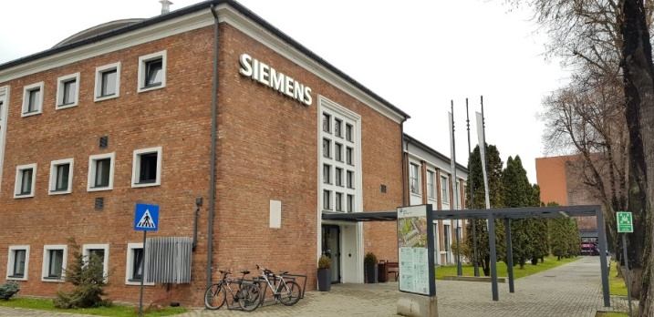
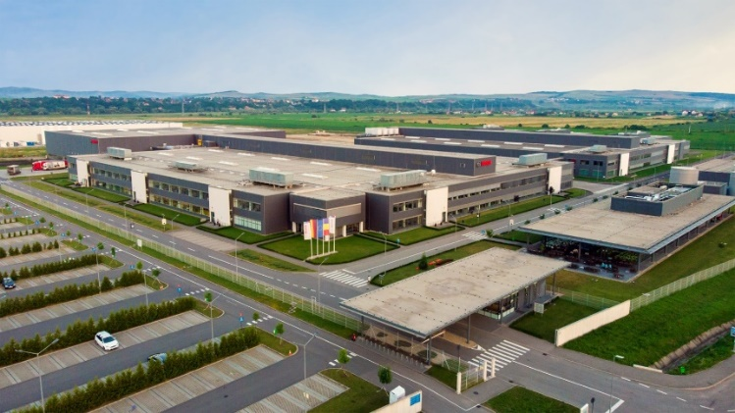
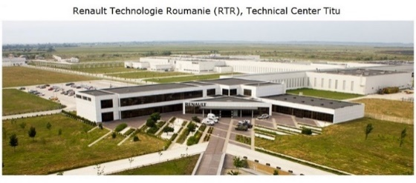
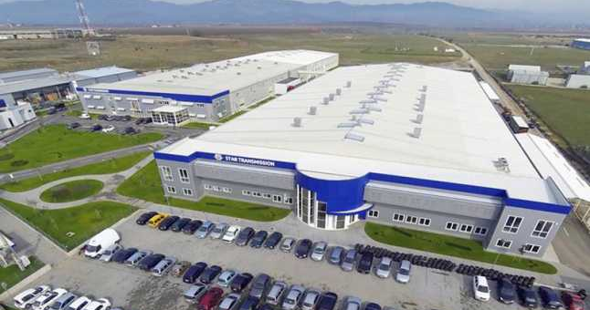
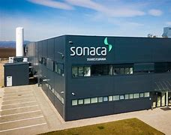
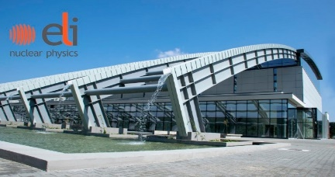
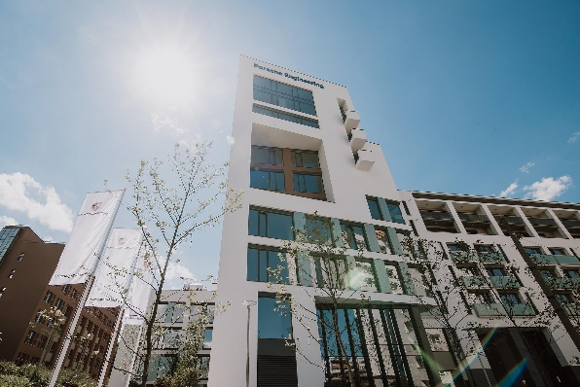
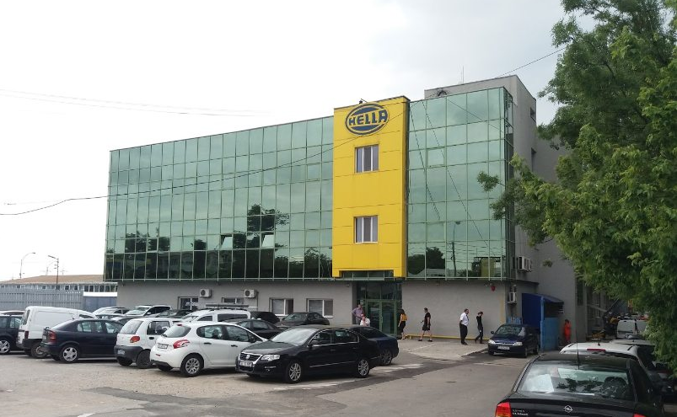
Centers of Excellence
BOSCH Cluj-Napoca
SIEMENS Cluj-Napoca
DAIMLER Sebes
SONACA Turda
ELI – NP Magurele
PORSCHE Engineering
Romania / Cluj-Napoca
HELLA Technical Center
Craiova

Slide 13
Romania,
competitive market
Electricity prices
S1 2024*
EU27 ranking
#11
0.1599 €/KWh
*Excluding VAT and other
recoverable taxes and levies
Fixed Broadband
# 10/155
235.12 Mbps for download
155.69 Mbps for upload
(Source: Speedtest Global Index,
Jan. 2025)
(Source: Eurostat dataset, Dec. 2024)
2
Hourly labor costs 2023
Natural gas prices
One of the most competitive labor force in the EU (€11)
S1 2024*
EU27 ranking
#6
0.0479 €/KWh
(Source: Eurostat, April 2024)
*Excluding VAT and other recoverable taxes and levies
(Source: Eurostat dataset, Dec. 2024)
Notes:
https://atlas.cid.harvard.edu/rankings Harvard University - economic complexity ranking
Harvard University - economic complexity ranking (133 countries) – 19 - Ahead of Belgium (20), Denmark (24), Poland (25), Estonia (27), Netherlands (26), Lithuania (30), Croatia (31) and Spain (34) (Source: Harvard, The Atlas of Complexity 2021)
APA/CANAL – nu sunt date la nivel EU
La nivel national, pretul minim fara TVA este 3,52 lei / mc
TVA pt apa/canal 9%

Slide 14
Value for money
 | BUCHAREST | BERLIN | LONDON
Consumer Prices* | €100 | €157 | €201
Rent Prices | €100 | €226 | €485
Restaurant Prices | €100 | €138 | €181
Groceries Prices | €100 | €154 | €168
Standard of living equivalency net salary | €3015 | €5296 | €7928
(Source: Numbeo, January 13, 2025)
*without rent
Numbeo is the world’s largest cost of living database. Numbeo is also a crowd-sourced global database of quality of life information including housing indicators, perceived crime rates and quality of healthcare, among many other statistics.
Notes:
Last updated, 13 Jan 2025
Family of four estimated monthly costs are 2,309.2€ (11,489.3 lei) without rent
A single person estimated monthly costs are 661€ (3,288.7 lei) without rent

Slide 15
Value for money
 | BUCHAREST | PARIS | BRUSSELS
Consumer Prices* | €100 | €179 | €163
Rent Prices | €100 | €278 | €212
Restaurant Prices | €100 | €149 | €166
Groceries Prices | €100 | €196 | €167
Standard of living equivalency net salary | €3015 | €6055 | €5229
(Source: Numbeo, January 13, 2025)
*without rent
Numbeo is the world’s largest cost of living database. Numbeo is also a crowd-sourced global database of quality of life information including housing indicators, perceived crime rates and quality of healthcare, among many other statistics.
Notes:
Last updated, 13 Jan 2025
Family of four estimated monthly costs are 2,309.2€ (11,489.3 lei) without rent
A single person estimated monthly costs are 661€ (3,288.7 lei) without rent

Slide 16
Tax system
Standard Corporate Income Tax
Income Tax
16%
10%
Reinvested Profit Tax
0%
Dividend Tax Rate
10%
Employer
Employee
Social Security
2.25%
Social Security
19%
35%
Standard VAT
0% income tax for employers and employees that exclusively perform R&D and innovation activities or related activities, 0% profit tax for the first 10 years of activity
Specific deduction for R&D eligible expenses:
- accelerated depreciation of R&D equipment
- additional corporate tax deduction of 50% of the eligible expenditure for these activities
Notes:
Standard contributions
Social Security Contributions for Employer:
- 2,25% - Work insurance contribution
Social Security Contributions for Employee:
- 10% - Health contribution
- 25% - Pension contribution
0% tax on reinvested profit in new technological equipment
0% tax on reinvested profit in supporting vocational-dual education
ACCACE 2024 Tax Guideline for Romania (February 28, 2024)
Tax exemptions for reinvested profit
The profit invested in new and specific technological equipment manufactured and/or purchased released for use is exempt from income tax. In order to benefit from this incentive, the technological equipment should be used by the company for the purpose of carrying on the business activity for more than half of its useful life, but for no longer than five years. The companies benefiting from this incentive cannot use the accelerated depreciation method for the respective technological equipment.
It is also exempt from corporate income tax, the profit invested in supporting vocational-dual education by ensuring the practical training and quality training of students.

Slide 17
Comparative tax in EU
(Source: Taxsummaries.pwc.com, EY)
(Notes: Estonia, Latvia, Hungary, Malta and Cyprus - no dividend tax for non-resident companies;
Finnish corporations paying certain types of income are required to apply a 20%, 15%, or 35% WHT on payments to foreign corporations)
Notes:
Corporate income tax - https://taxsummaries.pwc.com/quick-charts/corporate-income-tax-cit-rates
Standard VAT - https://taxsummaries.pwc.com/quick-charts/value-added-tax-vat-rates#qc-6770a061-445aba74-47b330a5-98dacced-dfcd976d-2cc3f309-a5f408f7-e4ad428c-4485ee21-08fc2c25-8335f40c-102eb896-d89d9935-7cab83e5-561fb3a9-fa07c45c-7b9bc1c3-c4860299-b3388ec7-bf687ec6-2af61a0a-e0ac4430-5f66ddfb-011e0058-bb3ce427-7a194092-b12ecd5d
Dividends - Finnish corporations paying certain types of income are required to apply a 20%, 15%, or 35% WHT on payments to foreign corporations and a 30% or 35% WHT on payments to non-resident individuals or other than corporate entities. WHT rates on dividends for non-residents vary on a case-by-case basis (as it is, e.g., dependent on a legal form of the payer and the recipient).
https://taxsummaries.pwc.com/quick-charts/withholding-tax-wht-rates#

Slide 18
Investment support
STATE AID - GD 300 / 2024
2024-2026 Total Budget: ~ € 450 Mill.
Annual Budget: ~ € 150 Mill.
Managed by: The Ministry of Finance
Financial support aimed at regional development through
investment stimulation
Minimum € 10 Mill. in eligible costs
Eligible expenses:
any type of new constructions
technical installations, new machines and equipment
depreciable assets associated with the initial investment such as patents, licenses, know-how or other intellectual property rights
The beneficiary must secure a financial contribution of at least 25% of the eligible costs, either through his own resources or through external financing, in a form that is not subject to any other public aid.
The investment must be maintained for at least 5 years after its completion.
Notes:
HOTĂRÂRE Nr. 300/2024 din 4 aprilie 2024 pentru instituirea unei scheme de ajutor de stat având ca obiectiv dezvoltarea regională prin stimularea realizării de investiţii
Scopul prezentei hotărâri îl reprezintă instituirea unei scheme de ajutor de stat cu impact major în economie, denumită în continuare schemă, având ca obiectiv dezvoltarea regională prin realizarea de investiţii care asigură echilibrarea balanţei comerciale a României în sectoarele care se regăsesc în anexa nr. 1.
Se pot emite acorduri pentru finanţare în baza prezentei scheme în perioada 2024 - 2026, cu respectarea legislaţiei în domeniul ajutorului de stat şi a hărţii regionale autorizate de Comisia Europeană, în limita bugetului anual alocat schemei.
Plata ajutorului de stat se efectuează în perioada 2025 - 2032, în baza acordurilor pentru finanţare emise, în limita bugetului anual alocat schemei.
Bugetul maxim al schemei este de 2.249,985 milioane lei, respectiv echivalentul a aproximativ 449,997 milioane euro,
Bugetul mediu anual al schemei este de 749,995 milioane lei, respectiv echivalentul a aproximativ 149,999 milioane euro.
Începând cu anul 2026, bugetul maxim anual al schemei care poate fi angajat cuprinde, pe lângă bugetul prevăzut la alin. (3), sumele stabilite cu această destinaţie, în anii anteriori, dar neutilizate, fără a depăşi creditele de angajament şi creditele bugetare aprobate prin legile bugetare anuale.
Numărul total estimat al întreprinderilor care urmează să beneficieze de ajutor de stat în baza schemei este de până la 150.

Slide 19
BT
SM
MM
SV
BN
IS
30%
SJ
BH
NT
Intensity
Map
STATE AID - GD 300 / 2024
CJ
40%
MS
HR
VS
AR
BC
AB
50%
HD
SB
BV
CV
GL
TM
VN
60%
BZ
70%
CS
VL
AG
PH
BR
GJ
TL
DB
Ineligible
IF
IL
MH
Bucharest
30%-40%
OT
CL
CT
DJ
TR
GR
(Source: The Official Monitor, April 4th, 2023)

Slide 20
Investment support
STATE AID - GEO 68 / 2023 ConstructPlus
2023-2026 Total Budget: ~ € 596 Mill.
2024 Budget: ~ € 149 Mill.
Managed by: The Ministry of Economy, Entrepreneurship and Tourism
Financial support of investments for the establishment and/or development of production capacities for construction products and materials
Eligible expenses: investment in tangible assets (buildings, land, technical installations, machinery and equipment) and intangible assets (patents, licenses, know-how or other intellectual property rights) related to the establishment of a new unit, expanding the capacity of an existing one or diversification of a production unit.
Maximum amount: € 50,000,000 depending on the county where the investment is located.
The investment must be maintained in the beneficiary region for a minimum of 5 years after its completion or, at least 3 years for SMEs.
Notes:
HOTĂRÂRE Nr. 300/2024 din 4 aprilie 2024 pentru instituirea unei scheme de ajutor de stat având ca obiectiv dezvoltarea regională prin stimularea realizării de investiţii
Scopul prezentei hotărâri îl reprezintă instituirea unei scheme de ajutor de stat cu impact major în economie, denumită în continuare schemă, având ca obiectiv dezvoltarea regională prin realizarea de investiţii care asigură echilibrarea balanţei comerciale a României în sectoarele care se regăsesc în anexa nr. 1.
Se pot emite acorduri pentru finanţare în baza prezentei scheme în perioada 2024 - 2026, cu respectarea legislaţiei în domeniul ajutorului de stat şi a hărţii regionale autorizate de Comisia Europeană, în limita bugetului anual alocat schemei.
Plata ajutorului de stat se efectuează în perioada 2025 - 2032, în baza acordurilor pentru finanţare emise, în limita bugetului anual alocat schemei.
Bugetul maxim al schemei este de 2.249,985 milioane lei, respectiv echivalentul a aproximativ 449,997 milioane euro,
Bugetul mediu anual al schemei este de 749,995 milioane lei, respectiv echivalentul a aproximativ 149,999 milioane euro.
Începând cu anul 2026, bugetul maxim anual al schemei care poate fi angajat cuprinde, pe lângă bugetul prevăzut la alin. (3), sumele stabilite cu această destinaţie, în anii anteriori, dar neutilizate, fără a depăşi creditele de angajament şi creditele bugetare aprobate prin legile bugetare anuale.
Numărul total estimat al întreprinderilor care urmează să beneficieze de ajutor de stat în baza schemei este de până la 150.

Slide 21
BT
SM
MM
SV
BN
IS
30%
SJ
BH
NT
CJ
40%
Intensity
Map
GEO 68 / 2023
ConstructPlus
MS
HR
VS
AR
BC
AB
50%
HD
SB
BV
CV
GL
TM
VN
60%
BZ
70%
CS
VL
AG
PH
BR
GJ
TL
DB
Ineligible
IF
IL
MH
Bucharest
35%-45%
OT
CL
CT
DJ
TR
GR
(Source: The Official Monitor, July 7th, 2023)

Slide 22
Investment support
STATE AID - GD 959 / 2022
2022-2027 Total Budget: € 300 Mill.
Annual Budget: € 150 Mill.
Managed by: The Ministry of Economy, Entrepreneurship and Tourism
Financial support for investments in the manufacturing industry, in the forms of grants for Greenfields or for projects favoring a new economic activity
Minimum € 3 Mill. investment value
Eligible expenses:
Starting a new unit / new activity
Expanding the capacity of an existing unit (except for large enterprises from Ilfov)
Diversifying the production through products that were not previously manufactured in the unit
Fundamental change of the general production process of an existing unit (except for large enterprises from Ilfov)
Acquisition of the assets from a closed unit or from a unit that would have been closed in case an independent investor had not been acquired the assets
Creating new jobs
The investment must be maintained in the beneficiary region for a minimum of 5 years after its completion or, at least 3 years for SMEs.

Slide 23
BT
SM
MM
SV
BN
IS
SJ
BH
NT
Intensity
Map
STATE AID - GD 959 / 2022
CJ
30%
MS
HR
VS
AR
BC
40%
AB
HD
SB
BV
CV
GL
50%
TM
VN
BZ
60%
CS
VL
AG
PH
BR
GJ
TL
DB
Ineligible
IF
IL
MH
Bucharest
35%-45%
OT
CL
CT
DJ
TR
GR
(Source: The Official Monitor, August 4th, 2022)

Slide 24
Investment support
STATE AID - GD 702 / 2024
2024-2026 Total Budget: € 447 Mill.
Annual Budget: € 149 Mill.
Managed by: The Ministry of Economy, Entrepreneurship and Tourism
Grants for an initial investment “per se”, or an initial investment generating a new economic activity
Minimum € 5 Mill. investment value
Eligible expenses:
a) costs of investments in tangible and intangible assets
b) estimated salary costs for jobs created following an initial investment, calculated over a period of 2 years
c) a merger between a fraction of the costs stipulated at ltr. a) and b) that should not exceed the value provided at ltr. a) or b), whichever is higher
The investment must be maintained in the beneficiary region for a minimum of 5 years after its completion or, at least 3 years for SMEs.

Slide 25
BT
SM
MM
SV
BN
IS
30%
SJ
BH
NT
Intensity
Map
STATE AID - GD 702 / 2024
CJ
40%
MS
HR
VS
AR
BC
AB
50%
HD
SB
BV
CV
GL
TM
VN
60%
BZ
70%
CS
VL
AG
PH
BR
GJ
TL
DB
Ineligible
IF
IL
MH
Bucharest
35%-45%
OT
CL
CT
DJ
TR
GR
(Source: The Official Monitor, June 21st, 2024)

Slide 26
Connectivity
17 International Airports with more than 100 direct flights worldwide.
Romania owns 1/3 of the Danube River, also standing as the most significant gateway to the Black Sea through Constanta Port, the largest and deepest harbor (25 meters) at the Black Sea (with a 6 days time saving competitive advantage against the biggest European port, Rotterdam, as concerns Asian goods transportation by sea).
Suceava
Satu Mare
Baia Mare
Iasi
Oradea
Bacau
Cluj-Napoca
Targu Mures
Arad
Galati
Sibiu
Sulina
Timisoara
Brasov
Braila
Tulcea
Drobeta
Turnu-Severin
M.Kogalniceanu
Bucharest, Otopeni
Constanta
Bucharest, Aurel Vlaicu
Mangalia
International Fligths
Craiova
Giurgiu
Ports
(Source: National Institute of Statistics)
Notes:
Source: The Romanian Airports Association (RAA)
ROMANIAN MEMBER AIRPORTS
ARAD INTERNATIONAL AIRPORT
Web: www.aeroportularad.ro Address: 4 Aeroportului Route, 310059 Arad, Romania Tel +40 257 339 010 | Fax +40 257 254 482 Email: office@aeroportularad.ro
BACAU GEORGE ENESCU INTERNATIONAL AIRPORT
Web: www.bacauairport.ro Address: 1 Aeroportului Street, 600324 Bacau, Romania Tel +40 234 575 400, 575 362 | Fax +40 234 575 366
Email: office@bacauairport.ro
MARAMURES INTERNATIONAL AIRPORT
Web: www.aimm.eu Address: 22 66th Street, 437345 Tautii Magheraus, Maramures, Romania Tel +40 262 293 444 | Tel/ Fax +40 264 223 394 Email: office@aimm.eu
BUCHAREST NATIONAL AIRPORTS COMPANY
Web: www.bucharestairports.ro Address: 224E Bucurestilor Route, 075150 Otopeni, Ilfov, Romania Tel +40 21 201 3304 | Fax +40 21 201 4990 Email: secretariat@bucharestairports.ro, secretariat@cnab.ro
CLUJ AVRAM IANCU INTERNATIONAL AIRPORT
Web: www.airportcluj.ro Address: 149 Traian Vuia Street, 400397 Cluj-Napoca, Romania Tel +40 264 416 636, 307 500 | Fax +40 264 416 712 Email: office@airportcluj.ro
CONSTANTA MIHAIL KOGALNICEANU INTERNATIONAL AIRPORT
Web: www.mk-airport.ro Address: 4 Tudor Vladimirescu Street, 907195 Mihail Kogalniceanu, Constanta, Romania Tel +40 241 255 100, 255 177 | Fax +40 241 508 022 Email: aeroport@mk-airport.ro
CRAIOVA INTERNATIONAL AIRPORT
Web: www.aeroportcraiova.ro Address: 325 Bucuresti Route, 200621 Craiova, Romania Tel +40 251 416 860 | Fax +40 251 411 112 Email: office@aeroportcraiova.ro
ORADEA INTERNATIONAL AIRPORT
Web: www.aeroportoradea.ro Address: 80 Calea Aradului Street, 410223 ORADEA, Romania Tel +40 259 416 082 | Fax +40 259 455 641 Email: airport@aeroportoradea.ro
IASI INTERNATIONAL AIRPORT
Web: www.aeroport.ro Address:34 Moara de Vant Street, 700750 Iasi, Romania Tel +40 232 271 590 | Fax +40 232 271 570 Email: iasi@aeroport.ro
SATU MARE INTERNATIONAL AIRPORT
Web: www.aeroportulsm.ro Address: Satu Mare-Zalau Highway, km. 9.5, Romania Tel +40 261 768 640 | Fax +40 261 768 776 Email: office@aeroportulsatumare.ro
SIBIU INTERNATIONAL AIRPORT
Web: www.sibiuairport.ro Address: 73 Alba-Iulia Highway, 550052 Sibiu, Romania Tel +40 269 253 981 | Fax +40 269 253 131 Email: secretariat@sibiuairport.ro
SUCEAVA STEFAN CEL MARE INTERNATIONAL AIRPORT
Web: www.aeroportsuceava.ro Address: 1 Aeroportului Street, 727475 Salcea, Suceava, Romania Tel/fax +40 230 529 999 Email: office@aeroportsuceava.ro
TIMISOARA TRAIAN VUIA INTERNATIONAL AIRPORT
Web: www.aerotim.ro Address: 2 Aeroport Street, 307210 Ghiroda, Timis, Romania Tel +40 256 386 089 | Fax +40 256 490 705 Email: office@aerotim.ro
TULCEA DELTA DUNARII INTERNATIONAL AIRPORT
Web: www.aeroportul-tulcea.ro Address: Tulcea-Constanta Highway, km. 15, 820250 Tulcea, Romania Tel +40 240 512 910 | Fax +40 240 511 040 Email: office@aeroportul-tulcea.ro
TUZLA AIRPORT
Web: www.regional-air.ro Address: Tuzla Airport, 907295 Constanta, Romania Tel +40 375 390 390 | Fax +40 0241 733 450 Email: office@regional-air.ro
TARGU MURES “TRANSILVANIA” INTERNATIONAL AIRPORT
Web: www.aeroportultransilvania.ro
Vidrasau, Șos. Targu-Mures – Luduș road, Km. 14.5 Mures, 547612, Romania
Tel +40 265 328 259 | Fax +40 265 328 257
Email: office@transylvaniaairport.ro

Slide 27
Industrial parks
118 modern industrial parks spread across Romania, with both private and public ownership, totaling 3,636.05 ha
Access to utilities & benefits packages according to their focus
Exemption on land, building and urban planning taxes
24
9
18
14
29
6
8
10
(Source: Ministry for the Public Works, Development and Administration, December 17, 2024)
Notes:
Situația parcurilor industriale (actualizat: 17/12/2024) – MDLPA.ro

Slide 28
Agriculture
Investment opportunities
Digitalization of the agriculture sector
Irrigation infrastructure, drainage and soil erosion
Mechanization and the extensive use of modern technology
Collecting, storage systems and processing of agriculture products
The Organic Farming segment
Romania is the country with the highest number of farmers in the EU, amounting to almost 3.5 million.
Romania is one of the biggest producers of cereals in the EU and the largest producer of sunflower seeds, honey and plums
The area in Romania used for agriculture constitutes almost 13.5 million ha
23% of the Romanian labour force are employed in agriculture, which is the highest percentage of people employed in agriculture in the EU
(Source: Eurostat)
Notes:
Data extracted on 15/04/2024 12:02:56 from [ESTAT] - Economic accounts for agriculture - values at current prices
Last updated: 02/02/2024 11:00
Agricultural indicator - Production value at basic price
EC approves EUR 241 mln Romanian aid scheme to support agricultural producers | Romania Insider (romania-insider.com)
The European Commission (EC) approved a Romanian scheme worth roughly EUR 241 million (RON 1.2 billion) to support the agricultural primary plant production sector in the context of Russia’s war against Ukraine.
Under the scheme, the aid will consist of limited amounts of direct grants, the Commission said, quoted by local news agency Agerpres.
The measure will be open to agricultural producers of some plant products, especially winter cereals and rapeseed producers, affected by market difficulties provoked by the war in neighboring Ukraine.
The aid will be at most EUR 280,000 per beneficiary and will be granted by June 30, 2024.

Slide 29
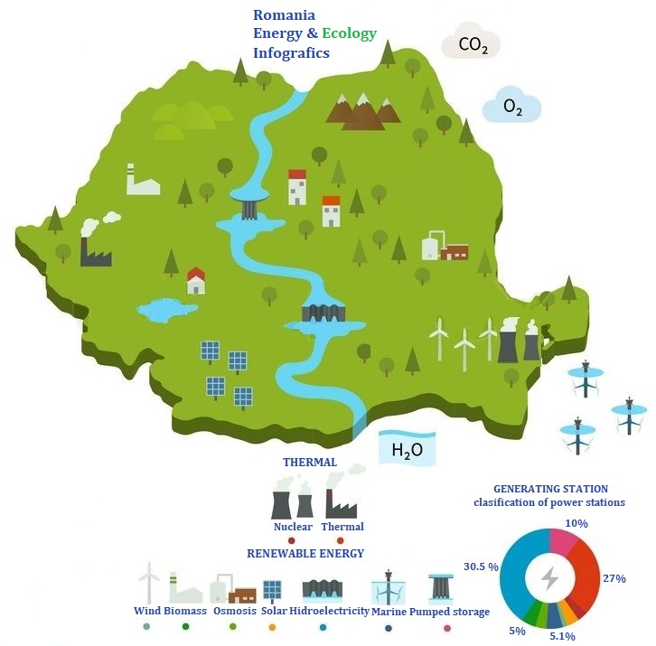
Energy
Romanian renewable energy market
Bioenergy
Solar energy
Wind
Hydropower
Hydrogen
Nuclear
Future projects with Government Support
Offshore wind parks of 300 MW
Power Plants Combined Cycle Gas Turbine
Smart grids and digitalization of electrical transport network
Photovoltaics parks of 700 MW
Romania will include in its national system for energy production the small modular reactors (SMR) by 2028, thus strengthening the partnership with the USA in the civil nuclear field.
Notes:
Acordul comercial va include o uzină NuScale cu 12 module, care va crea inițial peste 6.000 de locuri de muncă în SUA și România, cu potențialul creșterii acestora la 30.000, pe măsură ce proiectul va crește. Implementarea tehnologiei SMR va contribui la creșterea unui sector energetic fără carbon și cu emisii de gaz zero.

Slide 30
Largest IT&C companies in Romania

Slide 31
Key facts for top tech oriented industries
INDUSTRY SIZE
KEY PLAYERS
NEW KEY PROJECTS
€31 Bn
Dacia €60 M project for the manufacture of a new model
Ford Otosan €490 M project to produce electric cars
Nokian Tyres €650 M new passenger car tire factory
Daimler (Star Assembly) €135 M e-vehicle engine factory (starting 2024)
Continental €180 M investment in 2022 (R&D extension center & megafactory in Timisoara)
AUTOMOTIVE
Amazon €120 M new corporate office to develop innovations across areas like product safety, compliance, cloud computing, machine learning, and information security (2023)
Siemens has opened a regional service hub in the field of energy, IT and cyber security (2022)
Siemens software developers worked on the Mars Rover
Microsoft opened a Technology Development Center in Iasi (2020)
IT&C
€15.8 Bn
AEROSPACE
€678.9 M
Premium Aerotec €100 M investment
Sonaca €100 M investment
Airbus Helicopters €15 M investment
UAC Europe €100 M investment
Notes:
INDUSTRY SIZE - in 2022
Automotive - ACAROM - The Romanian Automotive Industry
IT&C - ZF supliment “Cele mai dinamice companii din Romania”, octombrie 2022
Aerospace - Top Firme CAEN 3030

Slide 32
Romania-Poland trade exchanges
2023 was a new record year for trade between Romania and Poland. So, at the end of 2023, bilateral trade registered an increase of +1.01%, registering 11.05 billion EUR, compared to the same period in 2022. Romanian exports decreased by -2.09% (to 3.43 billion EUR) and Polish exports to Romania increased by +2.46% (to 7.62 billion EUR).
On the end of December, 2024, bilateral trade registered an increase of +6.12%, registering 11.72 billion EUR, compared to the same period in 2023. Romanian exports increased by +8.51% (to 3.72 billion EUR) and Polish exports to Romania increased by +5.05% (to 8.00 billion EUR).
We are satisfied that a significant part of our business is based on high quality, manufactured and high value-added products (cars, electrical equipment, vehicles, transport equipment, clothing and furniture). However, Romania imports large quantities of agri-food products from Poland and Romanian exports represent only half of the Polish exports.
(Poland continues to have a surplus trade balance with most EU Member States, including Germany - its main trading partner, which accounts for 29% of its exports).

Slide 33
Polish investments in Romania
Between December 1990 and December 31, 2024, 1,757 companies with Polish capital were registered in Romania, with a directly invested capital of 425 million EUR. Poland ranks 18th among foreign investors in our country (compared to 24th at the beginning of 2013), with 0.85% of total foreign investment.
Polish-owned companies are currently involved in the chemical industry, food industry, construction materials, light metal packaging production, transport, tourism, commercial activities, IT etc.
The most important investment are done by: MASPEX - TYMBARK; CAN PACK; CIECH; CERSANIT Poland; BARLINEK; Enterprise Investors Poland; Selena Group; POLIMEX MOSTOSTAL; ASSECO Group; ATLAS Group; PKN ORLEN; LPP (with the brands Reserve, Cropp, House, Mohito, Sinsay); MODIVO S.A.; ALIOR Bank; Blachotrapez; PKO BP; BLIK; Zabka; Derek Group; Polenergia; Wittchen; Kontomatik etc.

Slide 34
InvestRomania in a nutshell
“one-stop-shop” for foreign investors, assisting and advising international companies for project implementation in the country
Promoting and facilitating foreign investment in Romania
Main interface between foreign companies and central / local authorities
Assisting worldwide entrepreneurs in project implementation
Tailored and individually custom-made solutions for
developing new or current units
Consultancy and guidance during all stages of the decisional process
(state aid & fiscal incentives)

Slide 35
National Contact Point
InvestRomania hosts the Romanian National Contact Point for Responsible Business Conduct (NCP) responsible with encouraging the observance of the OECD Guidelines for Multinational Enterprises and related information dissemination within the business communities and others interested parties.
National Contact Point for Responsible Business Conduct for the OECD Guidelines for Multinational Enterprises
https://mneguidelines.oecd.org/ncps/
The National Contact Point for Responsible Business Conduct (NCP) for the implementation of the recommendations made by the Organization for Economic Cooperation and Development (OECD) in the Guidelines for Multinational Enterprises works under the framework of the Government Decision no. 420/2005 as amended by the Government Decision no. 1430/2024.
The mandate of the National Contact Point for Responsible Business Conduct, presented in the Guidelines for Multinational Enterprises of the Organization for Economic Cooperation and Development (OECD) is two fold:
Promote and increase awareness on the OECD Guidelines for Multinational Enterprises and handle enquiries by organizing and participating in events related to RBC to raise awareness of the Guidelines and to address questions about the Guidelines
Provide a grievance mechanism to resolve cases (known as “specific instances”) relating to non observance of the recommendations of the Guidelines
The National Contact Point for Responsible Business Conduct provides a discussion forum and supports the business community, the employer’s organizations and other interested parties in reviewing the subject matter in an effective and timely manner and in accordance with the legislation in force.
Contact
National Contact Point for Responsible Business Conduct
E-mail: pnc@investromania.gov.ro

Slide 36
The OECD Guidelines for Multinational Enterprises
on Responsible Business Conduct
The OECD Guidelines for Multinational Enterprises on Responsible Business Conduct contains a series of recommendations for national governments of multinational enterprises, voluntary principles and standards for responsible business conduct in a global level, in accordance with the existing legislation.
The Guidelines aim to ensure that the operations of these enterprises are in harmony with government policies, to strengthen the basis of mutual confidence between enterprises and the societies in which they operate, to help improve the foreign investment climate and to enhance the contribution to sustainable development made by multinational enterprises.
The OECD Guidelines for Multinational Enterprises on Responsible Business Conduct cover fields such as:
Employment and Industrial Relations
Environment
Human Rights
Combating Bribery, Bribe Solicitation and Extortion
Consumers Interests
Science and technology
Competition
Taxation
“OECD GUIDELINES FOR MULTINATIONAL ENTERPRISES ON RESPONSIBLE BUSINESS CONDUCT” can be downloaded at: https://read.oecd-ilibrary.org/finance-and-investment/oecd-guidelines-for-multinational-enterprises-on-responsible-business-conduct_81f92357-en#page1

Slide 37
Ștefan POROJAN, Minister counsellor
Economic and Commercial Promotion Office
Embassy of Romania in the Republic of Poland
Tel: +48 22 621 5983 ext. 250; Mobile: +48 538 397 384
E-mail: varsovia.economic@mae.ro ; Website: http://varsovia.mae.ro
GOVERNMENT OF ROMANIA
Romanian Agency for Investment
and Foreign Trade
9-11 Promoroaca Street, District 1 Bucharest, Romania
E-mail:
investromania.gov.ro
office@investromania.gov.ro

